Slide 1
Agreement Protocols
Edited Slides of Prof Pallab Dasgupta

Slide 2
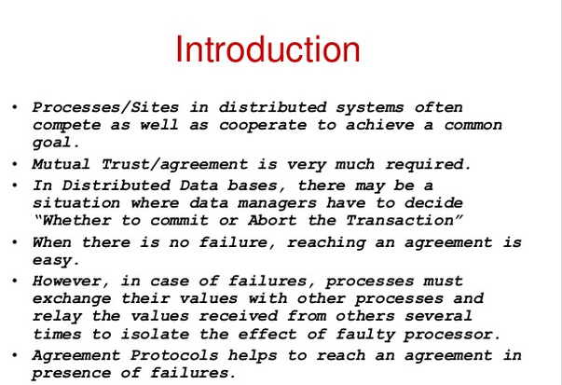

Slide 3
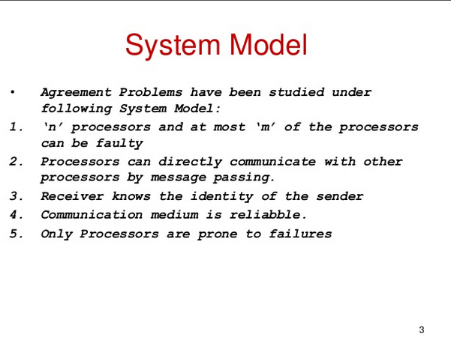

Slide 4
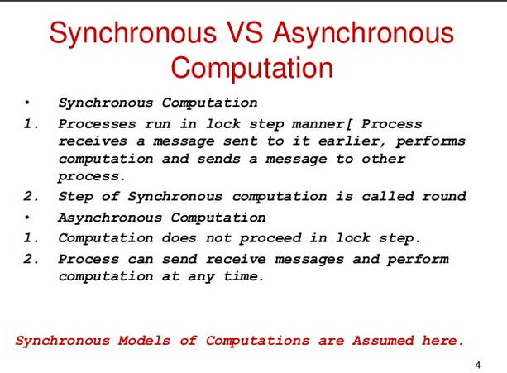

Slide 5
Applications of Consensus in Distributed Systems
Designed to achieve reliability in a network involving multiple unreliable nodes.
Required for decisions like
- Whether to commit a distributed transaction to a database
Consensus on leader (leader election)
What is the current value of the variable

Slide 6
Byzantine Agreement Problem
A designated process (source) with an initial value has to reach an agreement with the other processes about its initial value under the following conditions:
Agreement: All non faulty processes must agree on the same value
Validity: A decided value is the proposed value if the source is non faulty
Termination: Every correct process returns a value (decides)
Process is Byzantine if it deviates from some specification
-behave as crashed process
Send wrong information
-send different information to different processes

Slide 7
Byzantine Agreement
One process x broadcasts a value v
Agreement Condition: All non-faulty processes must agree on a common value.
Validity Condition: The agreed upon value by non faulty processes must be v if x is non-faulty. The agreed upon value can be any value (may not be v) if x is faulty.
2/3 non faulty majority needed

Slide 8
Variants of Byzantine agreement problem
Consensus
Each process broadcasts its initial value
All non-faulty processes must agree on a common value.
If initial value of all non-faulty processes is v, then the agreed upon value must be v
Interactive Consistency
Each process k broadcasts its own value v_{k}
All non-faulty processes agree on a common vector (v₁,v₂,…,v_{n})
If the k^{th} process is non-faulty and its initial value is v_{k}, then the k^{th} value in the vector agreed upon by non-faulty processes must be v_{k}. If kth process process is faulty then the kth value agreed upon by the non faulty process can be any value
Solution to Byzantine agreement problem implies solution to other two

Slide 9
Byzantine solution for Interactive Consistency
Solving Interactive Consistency using the Byzantine Solution
Interactive Consistency: Each process k broadcasts its own value v_{k.} All non-faulty processes agree on a common vector (v₁,v₂,…,v_{n}). If the k^{th} process is non-faulty, then the k^{th} value in the vector agreed upon by non-faulty processes must be v_{k}
Run the Byzantine solution on each process. Let the value broadcast by process 1 to n be v₁,v₂,…,v_{n.}
By the Byzantine solution, for each process Pi initiating the byzantine agreement solution, every non faulty process will agree on its value vi. Thus every non faulty process has agreed on the same value for each process that has initiated. The vector (v₁,v₂,…,v_{n}) is thus known and the same for every non faulty process. Satisfies Interactive Consistency

Slide 10
Interactive Consistency for Consensus
Solving Consensus Problem using Interactive Consistency Consensus Problem: Each process broadcasts its initial value
All non-faulty processes must agree on a common value.
If initial value of all non-faulty processes is v, then the agreed upon value must be v
Run the Interactive Consistency solution. Each non faulty process lands up with a common vector. Use a function that decides which among these to pick. Majority,min, max etc function could be used.
Hence given a solution to the Byzantine Problem we have a solution to both Consensus and Interactive Consistency Problem

Slide 11
Overview of Results
Agreement impossible in asynchronous case.
Even if we only want to tolerate a single crash failure.
True both for message passing and shared read-write memory. In a synchronised system, all systems will stop at certain points, sychronise and then move forward together. We study algorithms further for a sychronised setting.

Slide 12
Consensus Algorithm for Crash Failures (synchronous system)
n processes,
upto f < n processes may fail.
Crash failure indicates that the node can crash before/between/after sending msgs to the other processes but it wont send any wrong messages. Once it crashes it stops participating in any further activity forever.
The consensus variable x is integer value.
Each process has an initial value xi.
Upto f+1 rounds are executed
In each round process pi sends its value xi to all process if that value has not been sent before.
Process pi then takes min of all values received in the round and its own value.
Updates its own value to the min calculated
At the end of f+1 rounds all correct processes decide the same value.
Notes:
The algorithm does not satisfy the condition that if all non faculty proposed v then all should decide on v. the min value decided on can be that of a faulty process that crashes.

Slide 13
Consensus Algorithm for Crash Failures (synchronous system)
Code for each processor:
v := my input
at each round 1 through f+1:
if I have not yet sent v then send v to all
wait to receive messages for this round
v := minimum among all received values and
current value of v
if this is round f+1 then decide on v

Slide 14
Correctness of Crash Consensus Algo
Termination: By the code, finish in round f + 1.
Validity: Holds since processors do not introduce spurious messages
if all inputs are the same, then that is the only value ever in
circulation.

Slide 15
Correctness of Crash Consensus Algo
Agreement:
Suppose in contradiction p_{j} decides on a smaller value, x, than does p_{i}.
Then x was hidden from p_{i} by a chain of faulty processors:
There are f + 1 faulty processors in this chain, a contradiction.
round
1
round
2
round
f
round
f+1
q₁
q₂
q_{f}
q_{f+1}
p_{j}
p_{i}

Slide 16
Proof of correctness
Suppose correct processes Pi and Pj do not decide on the same value where Pj decides on a smaller value. The only way that Pi did not receive the smaller value x is if
all the processes in the sequence in which pj received it were faulty and
pj himself received it only at the f+1th round due to which he could not send this to all processes.
Now, - If Pj received it before round f+1 then pi would have received it in the f+1 th round.
If Pj received it at the f+1th round that means that all the processes on the path from the original process with min value till Pj were all faulty but you can have only f faulty processes and there are f+1 rounds. So atleast one process was non faulty and would have relayed this min information to Pi as well.

Slide 17
Performance of Crash Consensus Algo
Number of processors n > f
f + 1 rounds
Each round you have n² messages (each process to n-1 processes = n(n-1))
Thus total number of messages = (f+1) n²
Algorithm works even for n-1 crashes as long as you run it for n rounds.

Slide 18
Byzantine Agreement Problems
Model :
Total of n processes, at most m of which can be faulty
Reliable communication medium
Fully connected
Receiver always knows the identity of the sender of a message
Byzantine faults: behave as crashed, send wrong msgs or different mgs
Synchronous system
In each round, a process receives messages, performs computation, and sends
messages.

Slide 19
Byzantine Agreement Problem
No solution possible if:
asynchronous system, or
n < (3m + 1) where n =#generals, m=#faulty generals. (2/3 non faulty majority needed)
Lower Bound:
Needs at least (m+1) rounds of message exchanges
“Oral” messages – messages can be forged / changed in any manner, but the receiver always knows the sender

Slide 20
Byzantine Agreement:All non-faulty processes must
agree on a common value. The agreed upon value by
non faulty processes must be v if x is non-faulty.
Byzantine solution does not exist for N=3 and f=1
S
S
0
0
1
1
0
T
U
0
1
T
U
1
Scenario-1: S has to decide 0. Since loyal generals hence T decides 0
Scenario-2: Here S and U must agree. S has to decide 1. U decides on 1
S
Scenario-3: T’s situation is same as Scenario 1 and U’s as scenario 2. T decides 0, U decides 1.
Here T and U should agree but couldnt
0
1
0
T
U
1

Slide 21
H.W To show that a byzantine soln does not exist for N<=3f and f faulty generals, a reduction from Z(3,1) to Z( N<=3f,f) can be done. where Z (a,b) is the byzantine solution for a generals with b faculty generals among them.

Slide 22
Lamport-Shostak-Pease Algorithm
Synchronous Algorithm Broadcast( N, t ) where t is the resilience
For t = 0, Broadcast( N, 0 ):
Pulse
1 The general sends ⟨value, x_{g}⟩ to all processes,
the lieutenants do not send.
Receive messages of pulse 1.
The general decides on x_{g}.
Lieutenants decide as follows:
if a message ⟨value, x⟩ was received from g in pulse-1
then decide on x
else decide on udef

Slide 23
Lamport-Shostak-Pease Algorithm contd..
For t > 0, Broadcast( N, t ):
Pulse
1 The general sends msg to
all processes, the lieutenants
do not send.
Receive messages of pulse 1.
Lieutenant p acts as follows:
if a message msg was
received from g in pulse-1
then x_{p} = x else x_{p} = udef ;
Announce x_{p} to the other
lieutenants by acting as
a general in
Broadcast_{p}( N – 1, t – 1 ) in
the next pulse
The msg is of the form (v, Dest, List, t)
-v is the value being sent, -Dest is the set of processes this msg is yet to reach, -List is the set of processes already seen, -t is the current value in the total t+1 iterations to happen
When forwarding the value as B(N-1,t-1), the process Pi removes itself from Dest and adds himself to List. It then sends the msg to all processes in the set Dest.

Slide 24
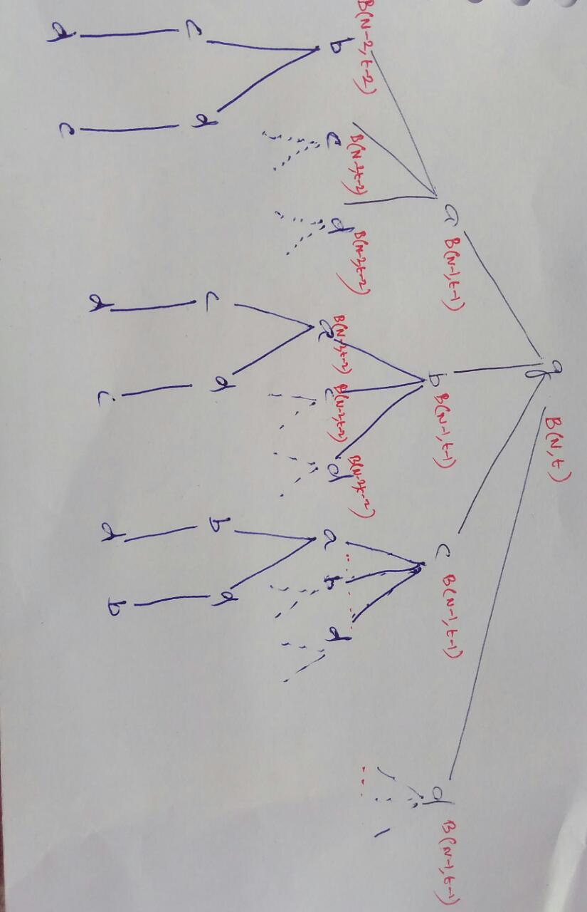

Slide 25
Lamport-Shostak-Pease Algorithm contd..
For t > 0, Broadcast( N, t ):
Decision taken by any lieutenant process p is the majority value among the decision taken by all lieutenants
Each broadcast is a byzantine agreement protocol in itself where all the non faulty generals have to agree on the same value. Hence when lieutenant q1 sends a broadcast, the byzantine agreement is about what all processes agree as the value sent to q1 by the general (that is, the value q1 has sent out as a temporary general)
Pulse
t +1 Receive messages of pulse t +1.
The general decides on x_{g}.
For lieutenant p:
A decision occurs in
Broadcast_{q}( N – 1, t – 1 ) for
each lieutenant q
W_{p}[q] = decision in
Broadcast_{q}( N – 1, t – 1 )
y_{p} = majoity (W_{p})

Slide 26
Additional Array
For a broadcast sent by Ps to a process Pi, the process Pi also creates an array of size k where k=|Dest| for the Dest received (one index for each process in the destination which includes one for itself). The index corresponding to Pi stores the value decided on by the subtree rooted at Pi, index for Process Pj stores the value decided Pi when it participated in the decision making of the subtree rooted at Process Pj for the similar broadcast sent to Pj by Ps. (Note, similar broadcast would have been sent to Pj by Ps if both Pi and Pj are in the Dest set received by Ps because Pi and Pj share a common parent Ps). Pi’s array stores for index of process Pj the value that Pi arrived at when it participated in the broadcast initiated (rooted at) by Pj. How does Pi know what Pj decided ?

Slide 27
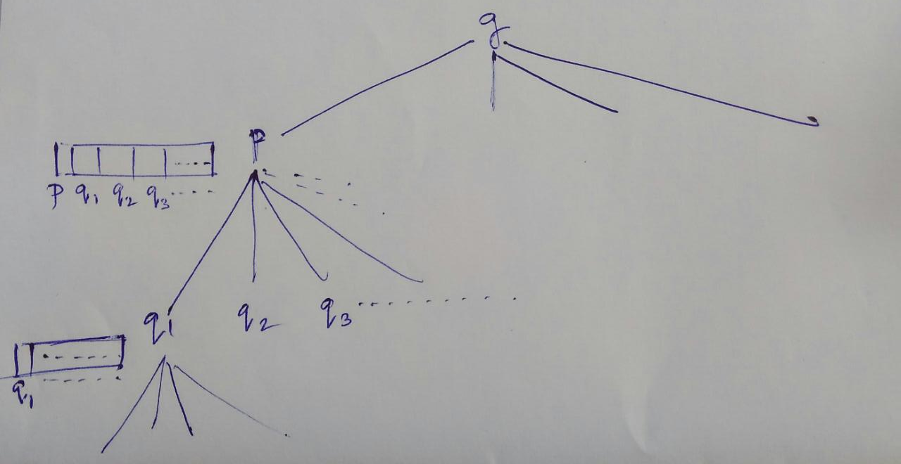

Slide 28
How does Pi know what Pj decided ?
Assume Pi and Pj to be non faulty. Since Pi and Pj are siblings having a common parent Ps, The Destination set sent to both are the same. Hence when Pi furthers the broadcast it removes only itself from the destination set.
Thus Pj is in the destination set of the broadcast that Pi sends out. Similarly Pi is in the destination set of the broadcast that Pj sends out.
Hence, Pj participates in Pi’s decision as Pj acts as a child in Pi’s broadcast. Similarly Pi acts as a child node in Pj’s broadcast.
Value arrived at by Pi when participating in Pj’s broadcast is the value stored by Pi in his local array for index of Pj
Notes:
The value decided for broadcast B(n-1,t-1) of process q is the value that all lieutenants agree as the value that g had sent q.

Slide 29
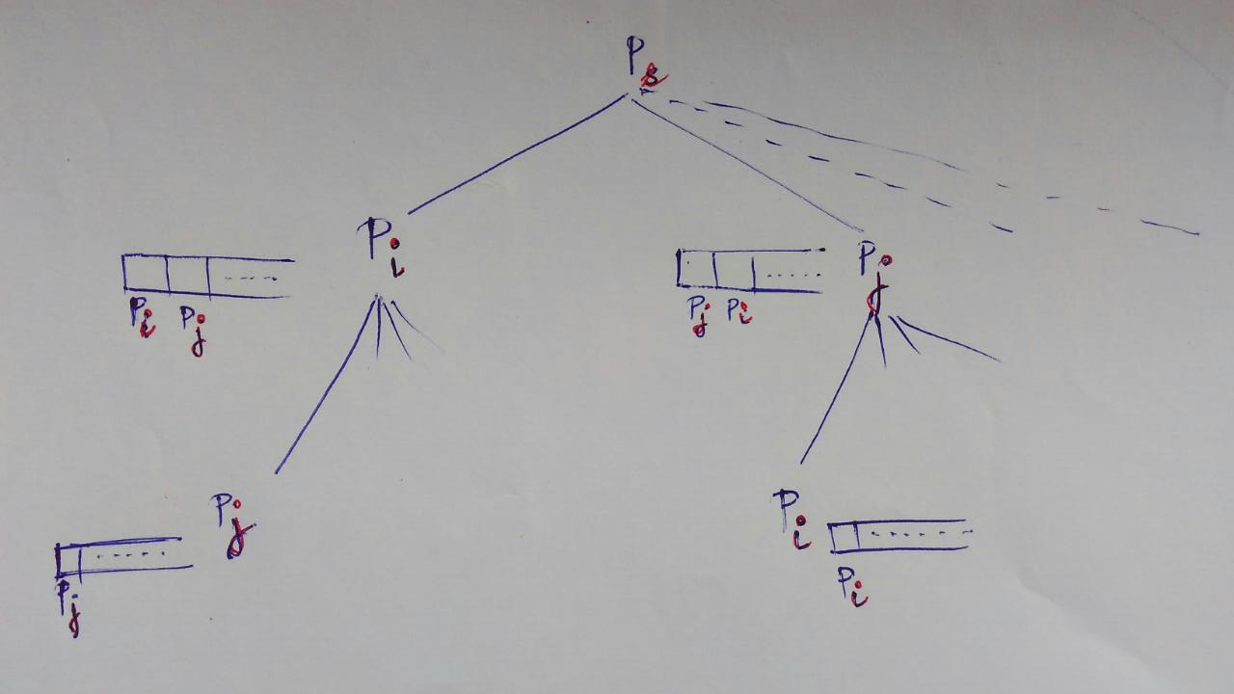

Slide 30
Observation
In case of a faulty general all the arrays of the correct processes are the same.
Example: For two correct process Pi and Pk
If Pi has 001101 then Pk too has 001101
In case of a loyal general, all correct process agree on the same value. That is, the subarray compassing of the positions of the loyal lieutanents of every correct process has the same bit (either 0 or 1). Say among the 6 (N) bits the first 4 (first 2N/3) are those of the loyal lieutenants and the last 2 (last N/3 )are of the faulty ones. Then for two correct process Pi and Pk then
If Pi has 111101 then Pk has 111110. The first four bits will be the same for all.

Slide 31
Please refer to the Kshemkalyani text book for a detailed Proof
To Prove all correct processes decide on the same value
Two cases: General is loyal
General is not loyal

Slide 32
Please refer to the Kshemkalyani text book for a detailed Proof

Slide 33
Loyal general
Lemma: If the general is correct, if there are f faulty processes , and if N>2f+t, then all correct processes decide on the input of the general.
Proof:
Base case: for Broadcast(N,0) general and all lieutenants agree on the same value. Assume Lemma true for N-1. Now for non faulty general, for the subtree N-1 you have still f faulty generals.
By Induction Hypothesis: For Broadcast (N-1,t-1) if we assume the Lemma to be true, then for each broadcast of form B(N-1,t-1) by a loyal process pi , all loyal lieutenants will decide on the input sent by pi(say x) as the majority bit in their local array after returned values of their respective broadcasts B(N-2,t-2).
Putting things together: Thus, By induction we saw that for lieutenants say p, the process p took the value x and did a broadcast_{p}(N-1,t-1) as the general. All other correct processes decided on x as the value in its local array for the index of p. Similarly consider the other correct lieutentants q,r,etc all who start with the same input x sent by the correct general. Thus all correct processes have the same bit x in the index of all correct processes. Given that correct processes always form majority of the array, we have the bit x as majority. Thus each lieutenant decides on x.
Notes:
Out of t+1 iterations, After t iterations (last iteration does not need majority), we have N-t processes with worst case all f faulty still present. But N-t >2f (by starting assumption). So N-t has non faulty majority .

Slide 34
Faulty general (cont)....
Lemma: Given t, the algorithm is correct if t>=f and there are a total of 3t+1 or more processes.
Base Case: For t=0, the lieutenants will just take the value of the general and decide on it hence all correct processes decide the same value.
Assume true for t=x. To show the lemma is correct for t=x+1
Since at t=x we have if x>=f then x+1>=f+1. Also we now have atleast 3(x+1)+1 =3x+4 processes of which at most x+1 could be faulty.
If the general is loyal: Previous lemma shows that algorithm is correct
If the general is faulty: Then after the faulty general msgs the lieutenants, we have x remaning faulty generals and more than 3x+1 processes. Using the induction hypothesis, for the second level ( level N-1,t-1), we have the lemma to be true implying that for a sent input, all non faulty processes agree on the same value. Hence, if we are to look at the local arrays of two non faulty processes Pi and Pj then, for every index both would have agreed on the same bit. Similarly since lemma is true at level 2, all non faulty processes come to consensus for whatever value a faulty process sent.So the local array index of the non faulty process is filled by the same bit in the locall arrays of all non faulty processes, That is, all non faulty process have the same array with the same bit occupying indexes of both faulty and non faulty. Since the arrays are the same Hence, the majority decided by each non faulty process is the same.

Slide 35
Features
Termination: If Broadcast( N, t ) is started in pulse 1, every process decides in pulse t + 1
Dependence: If the general is correct, if there are f faulty processes, and if N > 2f + t, then all correct processes decide on the input of the general
Agreement: All correct processes decide on the same value
The Broadcast( N, t ) protocol is a t-Byzantine-robust broadcast protocol for t < N/3
Time complexity: O( t + 1 ) Message complexity: O( N^{t} )

